Slide 1
How does an antenna that only generates a magnetic field, generate an electromagnetic (EM) wave?

Slide 2
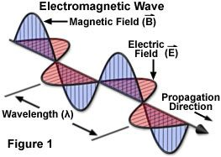
Electromagnetic (EM) Wave
Made up of two time varying components:
Electric field (E)
Magnetic field (B)
Electric and magnetic fields
Orthogonal and in phase
Are tightly coupled to each other
Propagate through space at the speed of light
How do we know this: Maxwell’ equations
Greatest physicists all time:
Newton (F= ma)
Einstein (E= mc²)
?

Slide 3
Electromagnetic (EM) Wave
Made up of two time varying components:
Electric field (E)
Magnetic field (B)
Electric and magnetic fields
Orthogonal and in phase
Are tightly coupled to each other
Propagate through space at the speed of light
How do we know this: Maxwell’ equations
Greatest physicists all time:
Newton (F= ma)
Einstein (E= mc²)
Maxwell (Maxwell’s equations)

Slide 4
Force Fields & EM Waves
Charged particle: free electron (which has a negative charge)
Constant electric field is produced by a stationary charged particle
Example: a capacitor with a DC charge
Constant magnetic field is produced by a moving charged
Important point: charges are moving at a constant velocity
Example: a DC current flowing thru a conductor
An EM wave is produced by an accelerating charged particle
Examples:
Particle accelerator
AC current flowing thru a conductor of sufficient length

Slide 6
Why Are Maxwell’s Equations Important
Show the link between electricity, magnetism and light
Show that light is a form of EM radiation
Break down under some conditions
Led Einstein to Theory of Relativity
Mathematical description of how EM waves are generated and altered

Slide 7
How Does An EM Wave Get Generated
From Maxwell’s equations:
A time varying electric field induces a time varying magnetic field
A time varying magnetic field induces a time varying electric field
This interplay between induced electric and induced magnetic fields leads to propagating electromagnetic waves
Most antennas do not launch an EM wave
They generate either a time varying electric field or a time varying magnetic field

Slide 8
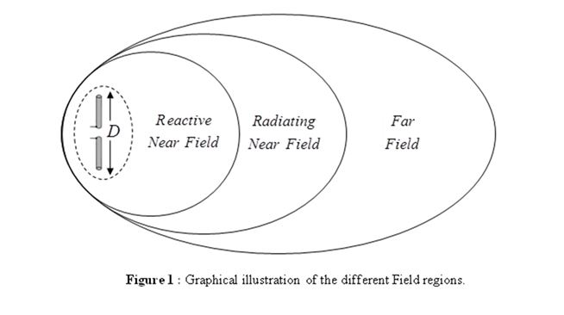
Spatial Fields (Distance From An Antenna)
Pure EM waves only exist in the Far Field

Slide 9
Spatial Fields (Distance From An Antenna)
Pure EM waves only exist in the Far Field
MHz
3.5 | 175 ft
144 | 4.3 ft
564 ft
14 ft

Slide 10
EM Wave From A Magnetic Field Generator
Conductor length must be > 0.05 wavelength to radiate
(LC tank circuits don’t radiate because they are << 0.05 wavelength)
Initially:
E & B fields are orthogonal but 90º out of phase
Energy goes back and forth between E & B fields
No radiation
Analogous to a lossless LC tank circuit
Reactive
Near-field

Slide 11
EM Wave From A Magnetic Field Generator
Length must be > 0.05 wavelength to start radiating
(This is why LC tank circuits don’t radiate)
Reactive
Near-field
Radiating
Near Field
(Transition region)

Slide 12
EM Wave From A Magnetic Field Generator
Length must be > 0.05 wavelength to start radiating
(This is why LC tank circuits don’t radiate)
E & B fields in-phase
Full radiation
No reactive energy
Far Field

Slide 13
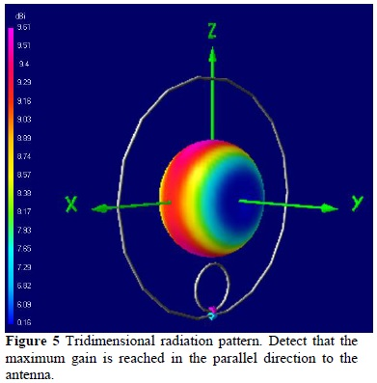
Magnetic Loop Antenna
RF
Far Field Pattern
Reactive
Near-field

Slide 14
Electric Field Antenna
+
DC
E Field
-

Slide 15
Electric Field Antenna
L> 0.05 wavelength
+
+
L/2
DC
=>
RF
=>
E Field
E Field
-
L/2
-
Reactive
Near-field

Slide 16
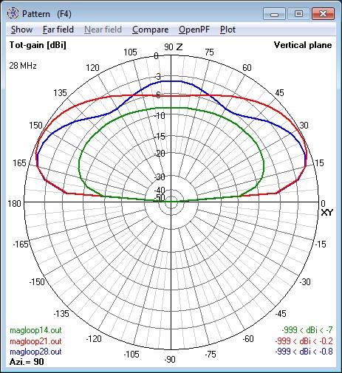
Magnetic Loop Antenna
Why is it called a Magnetic Loop antenna?
In the reactive near-field:
It generates a magnetic field on transmit and,
It responds primarily to the magnetic field of an EM wave when receiving
In the far field, there is no difference between the EM wave generated from a magnetic loop or from a dipole
Ground effects:
Near field: detuning and losses are minimal
Far field: similar to ground mounted vertical
Pseudo-Brewster angle notch-out

